Slide 1

Spark Installation
CSC 4760 / 6760 Big Data Programming
Spring 2018

Slide 2
Install VirtualBox and Ubuntu 16.04
VirtualBox Version 5.1.26 https://www.virtualbox.org/wiki/Downloads
Ubuntu 16.04
Ubuntu 16.04.1 LTS (Xenial Xerus)
http://releases.ubuntu.com/16.04/
64-bit PC (AMD64) desktop image
(http://releases.ubuntu.com/16.04/ubuntu-16.04-desktop-amd64.iso)

Slide 3
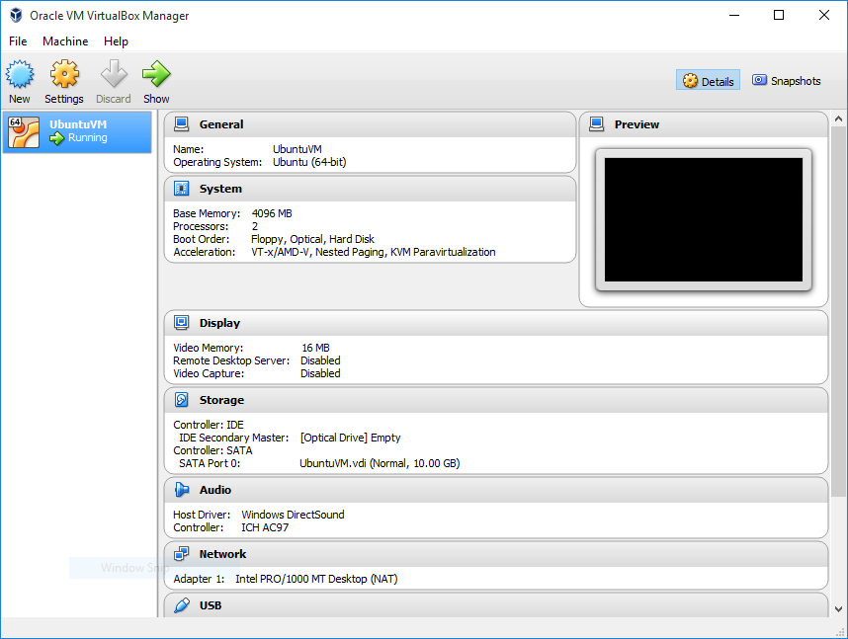
Ubuntu 16 in VirtualBox

Slide 4
Spark Installation
Verifying Java Installation: $ java -version
Verifying Scala Installation: $ scala -version
Downloading Apache Spark
Installing Spark
Verifying the Spark Installation: bin/pyspark or bin/spark-shell

Slide 5
Installing Scala
Install Scala
http://www.scala-lang.org/download/
Make sure you have the Java 8 JDK installed.
$ java -version
Download Scala Binaries for Unix (scala-2.12.4.tgz)
http://www.scala-lang.org/download/
Put the unzipped folder in the home directory “/home/rob/”
gedit ~/.bashrc add the following two lines to the end of the file
export SCALA_HOME=/home/rob/scala
export PATH=$SCALA_HOME/bin:$PATH
$ scala -version
$ echo $SCALA_HOME

Slide 6
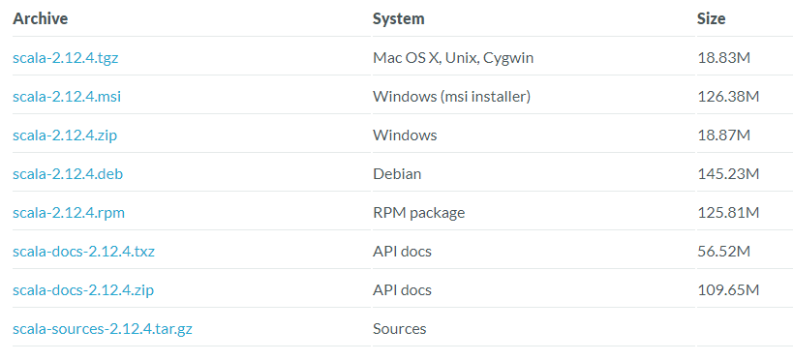
Install Scala
https://www.scala-lang.org/download/

Slide 7
Installing IntelliJ IDEA (an IDE similar to Eclipse)
Install Scala
http://www.scala-lang.org/download/
Download IntelliJ IDEA
https://www.jetbrains.com/idea/
Put the unzipped folder in the home directory “/home/rob/”
gedit ~/.bashrc add the following two lines to the end of the file
export IDEA_HOME=/home/rob/idea
export PATH=$IDEA_HOME/bin:$PATH
$ idea.sh // start IntelliJ IDEA
// You need to change rob to your user name

Slide 8
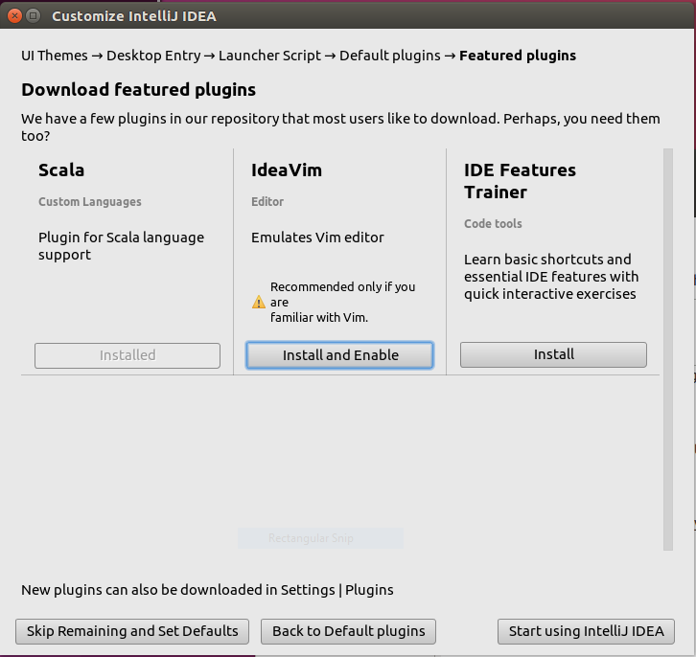
Customize IntelliJ IDEA
Install Scala
Other plugins

Slide 9
Installing Spark in Ubuntu 16.04
Download Spark : http://spark.apache.org/downloads.html
spark-2.2.1-bin-hadoop2.7.tgz
Unzip it and rename spark-2.2.1-bin-hadoop2.7 to spark
Put it in the home directory : /home/rob/spark
Run “pyspark” or “spark-shell”
$ gedit ~/.bashrc // add the following two lines to the end of the file
export SPARK_HOME=/home/rob/spark
export PATH=$SPARK_HOME/bin:$PATH

Slide 10
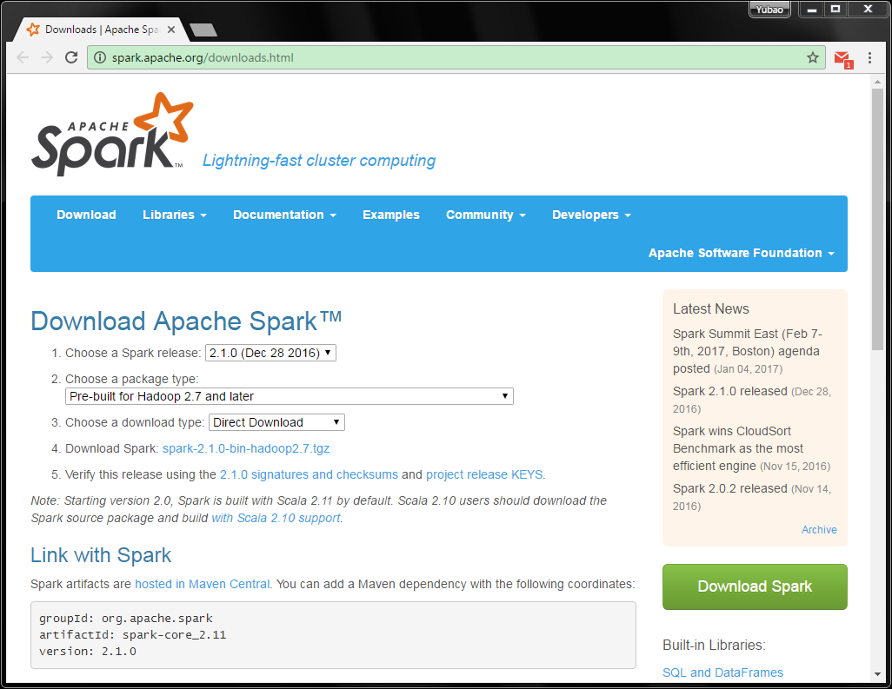
Install Spark
http://spark.apache.org/downloads.html

Slide 11
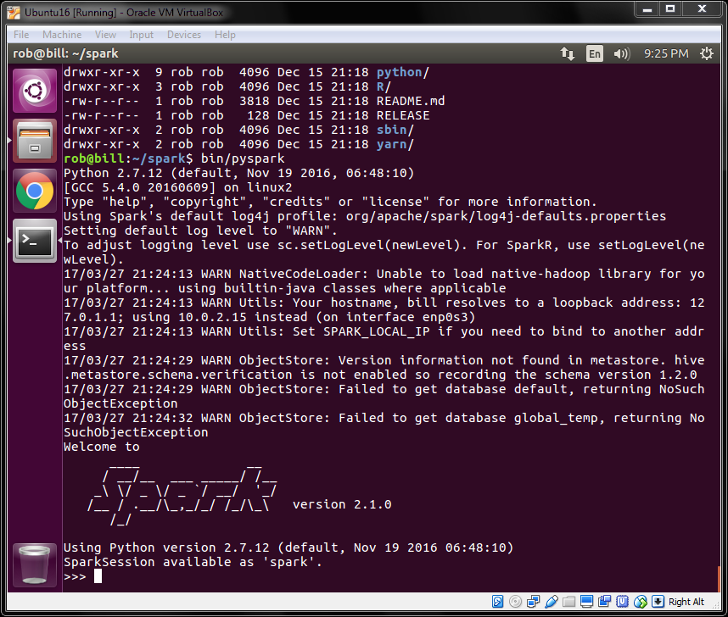
Run Pyspark
$ pyspark
For Python
You can also run
$ spark-shell
For scala

Slide 12
Spark’s Python and Scala Shells
Interactive Shells are available only in Python and Scala
Python
Scala
Batch/Standalone
Java
Python
Scala
The API is similar in every language.

Slide 13
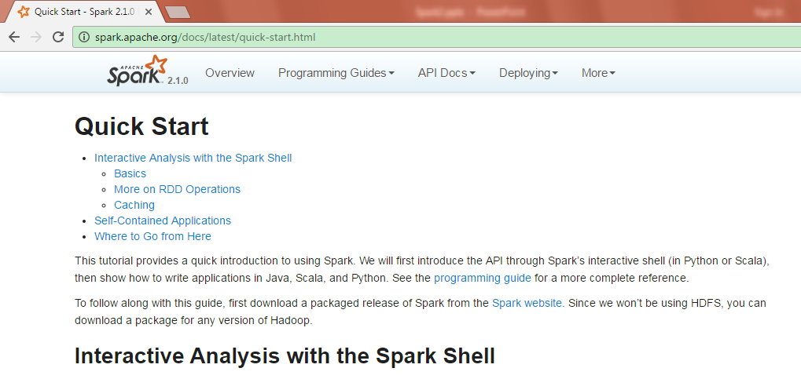
The Power of Spark’s Shells
Examples from the Quick Start Guide (http://spark.apache.org/docs/latest/quick-start.html)

Slide 14
Open up one of Spark’s shells
Python version of the Spark shell, a.k.a., PySpark shell
In the terminal, type: pyspark
Scala version of the Spark shell
In the terminal, type: spark-shell
Exit either shell: press Ctrl-D or input command : exit()

Slide 15
Create a RDD from a local text file (Python line count)
$ pyspark
>>> lines = sc.textFile(“/home/rob/Assignment1/test.txt") # Create an RDD called lines
>>> lines.count() # Count the number of items in this RDD
3
>>> lines.first() # First item in this RDD, i.e. first line of README.md
u'hadoop spark hadoop'
lines: An RDD

Slide 16
Create a RDD from a local text file (Scala line count)
$ spark-shell
scala> val lines = sc.textFile("/home/rob/Assignment1/test.txt") // Create an RDD called lines
lines: spark.RDD[String] = MappedRDD[...]
scala> lines.count() // Count the number of items in this RDD
res0: Long = 3
scala> lines.first() // First item in this RDD, i.e. first line of README.md
res1: String = hadoop spark hadoop
lines: An RDD

Slide 17
Read Data from Local FS or from HDFS
Read the text file from the local file system
book1 = sc.textFile(“/home/rob/data/peterpan.txt”)
Read the text file from HDFS
book2 = sc.textFile(“hdfs://localhost:9000/user/rob/data/peterpan.txt”)
host:port/directory localhost=127.0.0.1

Slide 18
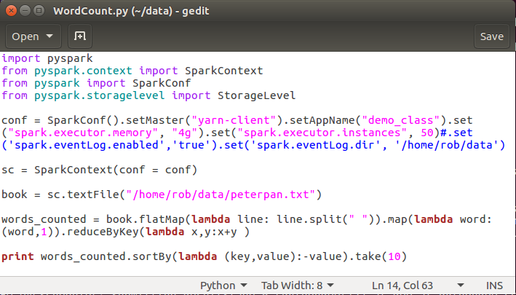
WordCount in Spark
$ spark-submit WordCount.py
output

